Slide 2

Presenter
Philip Mason has been a SAS programmer for 38 years, having spent 29 years as an independent SAS Consultant. Starting in Australia he then moved on to Europe working in Belgium, Netherlands and the U.K. where he is now based. He has written 3 books about SAS, and also written several SAS courses, founded some user groups, helped run Pharmasug, SAS Global Forum, and so on.
He currently works with SAS and JavaScript, helping a bio-tech called argenx in Belgium. But also on side-projects for BOTH Analytics in Germany & several other pharma companies.

Slide 3
Documenting your SAS programs with Doxygen and automatically generated diagrams.

Slide 4
Agenda
Documentation
Diagrams
Doxygen
Software makes doc
DoxyWizard
Sets up doxygen parms
Using tags
Documenting via comments
Example templates
PROC SCAPROC
What SAS writes/reads
Graphviz Overview
Make diagrams with text
SCAPROC -> Graphviz
Generate text directives
Automation

Slide 5
Documentation
We know we should do it

Slide 6
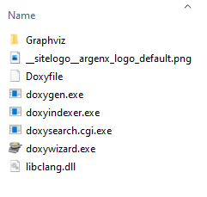
Install software
Getting started
Download doxygen.zip (from www.doxygen.nl)
Extract it to C:\doxygen
Doxywizard.exe is run to use a User Interface
Doxygen.exe can be run on command line to generate documentation
Graphviz/bin/dot.exe is used for generating graphs in documentation
Doxyfile contains suggested settings
Download doxygen_manual.pdf
Optionally download some samples from my Github repository
Notes:
Links are in paper and powerpoint

Slide 7
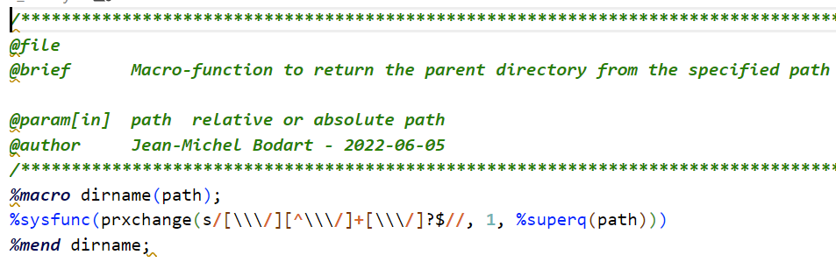
Documenting headers
How it works
Sample code
A single special comment block, starting with /**, ending with */
Tags start with @
@file
Makes a documentation entry for this source code
@brief this is a short description
Brief description of code
@details this is a longer description that can go over many lines
Detailed description
@author phil mason (pmason)
Name of author or user-id
@date 2023-01-01
Date code created
Tags are optional, except for @file
Programmers should at least use @file and @brief

Slide 8
Other useful parameters
@param[in] name description
Input parameters – could be macro variables, variables, datasets, etc.
@param[out] name description
Output parameters – could be macro variables, variables, datasets, etc.
@param[in,out] name description
Parameters used for input and output
@returns things returned by program
Datasets, files, macro variables
@code proc print data=sashelp.class;run; @endcode
Can put lots of code between the tags to show a code block
@pre this is a pre-condition for this code to run
Could be macro variables or datasets required
@warning this is a warning about something
Useful for those looking at documentation to be aware of this
Notes:
Parameters could be to a macro. Could be datasets used. You decide.

Slide 9
Handling example code
/**
@file
@brief this is a brief description.
@cond
*/
%macro nobs(dsid) ;
%sysfunc(attrn(&dsid,nobs))
%mend nobs ;
/**
@endcond
@file
#### Examples ####
@code
%put This dataset has %nobs(1) observations ;
@endcode
*/
Most header doc should go before the SAS code
I like example code after the SAS code
@cond stops Doxygen processing until @endcond is encountered
This allows skipping over the SAS code
@file is needed to continue documentation for the program
#### is markdown to make a level 4 header
@code / @endcode puts the example code into a coloured block

Slide 10
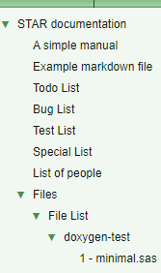
Making lists
Some tags not only show information in their own documentation page, but contribute to lists
Lists collect common information (e.g. bugs) from multiple program headers
@todo fix something later
Contributes to the Todo list
@bug here is something that doesn’t work
Adds to the Bugs list
@test here is a test to run
@xrefitem special "Special" "Special List" I can make special lists to gather items from multiple programs documentation.
This allows creating a custom list

Slide 11
Formatting text
Doxygen tags
@li list item (bullet point)
@b bold @c code @e emphasized @a argument
Using HTML
Most html tags are supported, - e.g. we can make tables for showing update history
Using Markdown
Markdown is supported so some useful conventions can be used, e.g.
##### Level 4 header ####
> block quote
- list item
`code block`
Read more about all this in documentation - Doxygen Manual: Special Commands - Doxygen Manual: HTML Commands - Doxygen Manual: Markdown support

Slide 12
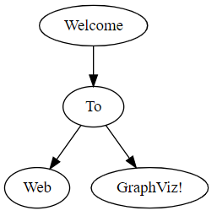
Diagrams
Diagrams can be made using the dot language – DOT Language | Graphviz
For example
@dot
digraph G {
"Welcome" -> "To"
"To" -> "Web"
"To" -> "GraphViz!” }
@enddot

Slide 13
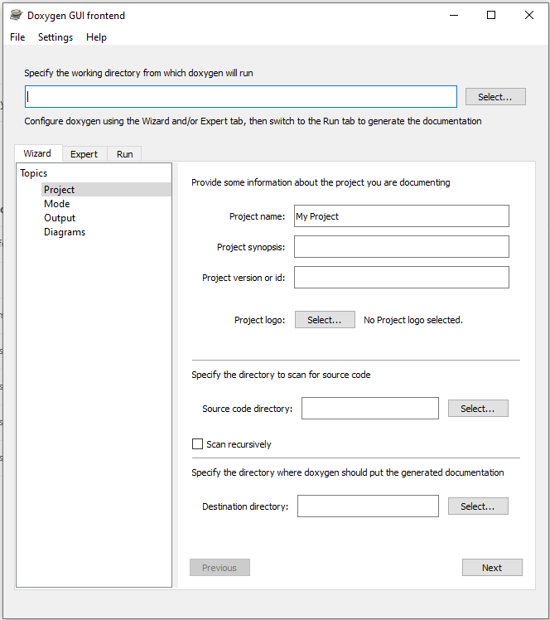
Start the wizard
Using the Doxygen Wizard
Run doxywizard.exe
It opens the user interface
Quick way to start is use settings we have prepared
File/Open
Select Doxyfile from the doxygen directory
You will see lots of settings have been populated

Slide 14
Key settings
Wizard tab
Source code directory should point to where your source code is
Scan recursively can be ticked if you want to use sub-directories too
Destination directory is where generated documentation will be put
Advanced tab
HTML
HTML_FILE_EXTENSION
can be set to .html if you are generating documentation to look at on your computer
Set to .aspx if you are generating documentation to deploy to SharePoint
Run tab
Run Doxygen to generate the documentation
Show HTML output will open browser to show you the documentation

Slide 15
/**
@file
@brief This is the brief description of the code.
@version optional info
@copyright optional info
@details This is a more detailed description of what happens in the program.
Which can go over multiple lines,
and can have SAS code sections:
@code
Proc print ;
run;
@endcode
And then can continue on with more description.
This is a highlighted block which could be used for code
because it is indented by some spaces
And back to normal documentation when there is no indent.
I can highlight things like @b bold text, an @a argument, some @e emphasized text,
some @c code.
You can use html too like: <tt>Some code could be here</tt><p/>
Or <u>Underlined</u>, <b>bold</b>, <br/>
<A HREF="https://doxygen.nl/manual/htmlcmds.html">HTML Commands</a>
@author name goes here
@author another author name goes here
@date 21 Oct 2022 first version of program
@date 1 Jan 2023 next version
@param parm1 this is a parameter description
@param[in] parm2 this is an input parameter description
@param[out] parm3 this is an output parameter description
@param[in,out] parm4 this is a parameter description for something that is input and output
@returns This describes what the code returns
@pre Pre-condition for using the code, for instance some macro variables need to be set first
@warning Warning about how to use the code
@test talk about testing here
@todo Record things here that are still to do
@bug Record any known bugs here
@xrefitem special "Special" "Special List" I can make special lists to gather items from multiple programs documentation.
<h4>Update History</h4>
<table>
<tr><th>Date</th><th>Name</th><th>Description</th></tr>
<tr><td> ---- </td><td> ---- </td><td> ---- </td></tr>
</table>
<h4>Examples</h4>
@code
@endcode
<h4>SAS Called</h4>
@li gplot.sas is used in some way
@li b.sas some comments about it
@li c.sas (this one does not exist yet, so doesn't get a link)
<h4>Diagram(s)</h4>
@dot
digraph example {
in -> out
out -> report
}
@enddot
**/
Suggested template
Notes:
Part 1 of 3

Slide 16
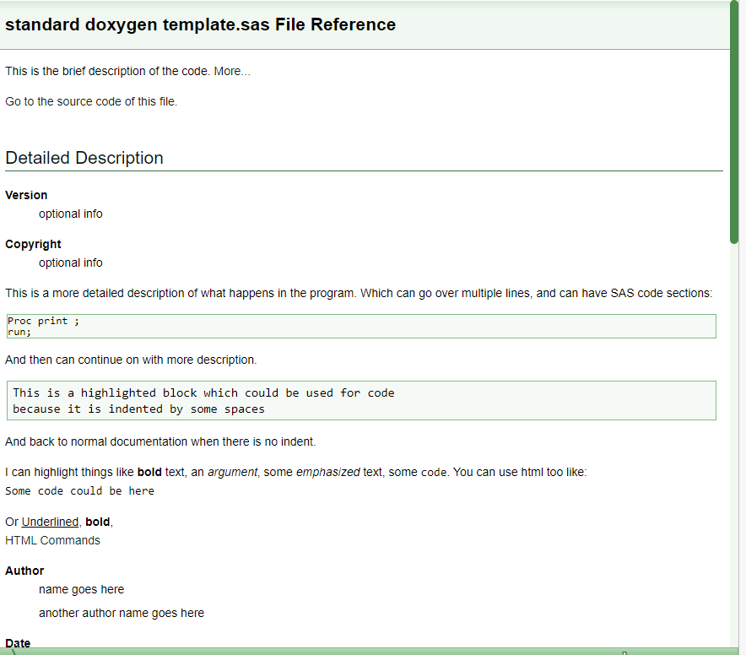
Notes:
Part 1 of 3

Slide 17
/**
@file
@brief This is the brief description of the code.
@version optional info
@copyright optional info
@details This is a more detailed description of what happens in the program.
Which can go over multiple lines,
and can have SAS code sections:
@code
Proc print ;
run;
@endcode
And then can continue on with more description.
This is a highlighted block which could be used for code
because it is indented by some spaces
And back to normal documentation when there is no indent.
I can highlight things like @b bold text, an @a argument, some @e emphasized text,
some @c code.
You can use html too like: <tt>Some code could be here</tt><p/>
Or <u>Underlined</u>, <b>bold</b>, <br/>
<A HREF="https://doxygen.nl/manual/htmlcmds.html">HTML Commands</a>
@author name goes here
@author another author name goes here
@date 21 Oct 2022 first version of program
@date 1 Jan 2023 next version
@param parm1 this is a parameter description
@param[in] parm2 this is an input parameter description
@param[out] parm3 this is an output parameter description
@param[in,out] parm4 this is a parameter description for something that is input and output
@returns This describes what the code returns
@pre Pre-condition for using the code, for instance some macro variables need to be set first
@warning Warning about how to use the code
@test talk about testing here
@todo Record things here that are still to do
@bug Record any known bugs here
@xrefitem special "Special" "Special List" I can make special lists to gather items from multiple programs documentation.
<h4>Update History</h4>
<table>
<tr><th>Date</th><th>Name</th><th>Description</th></tr>
<tr><td> ---- </td><td> ---- </td><td> ---- </td></tr>
</table>
<h4>Examples</h4>
@code
Proc Print data=sashep.class ; run ; @endcode
<h4>SAS Called</h4>
@li gplot.sas is used in some way
@li b.sas some comments about it
@li c.sas (this one does not exist yet, so doesn't get a link)
<h4>Diagram(s)</h4>
@dot
digraph example {
in -> out
out -> report
}
@enddot
**/
Notes:
Part 2 of 3

Slide 18
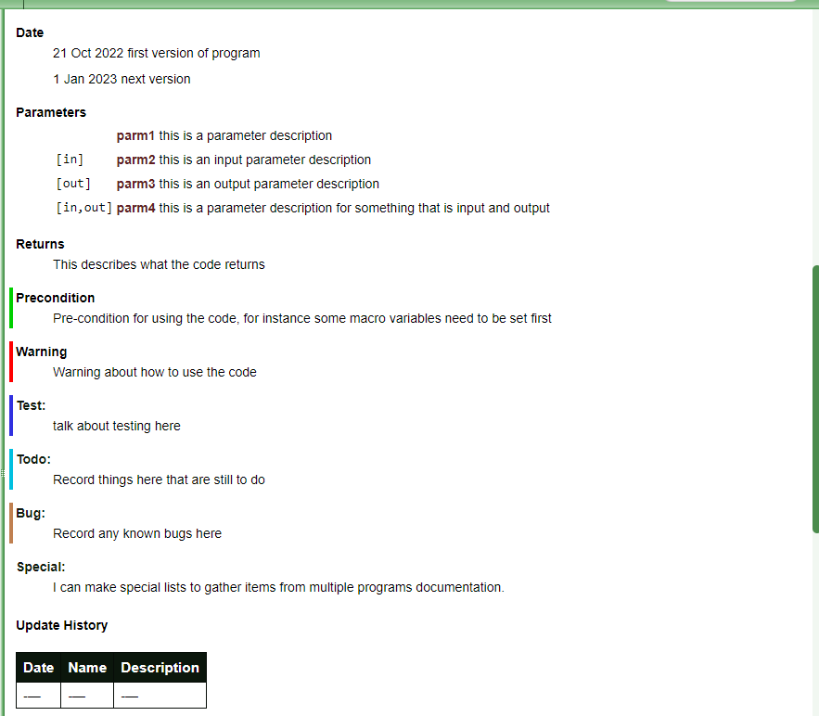
Notes:
Part 2 of 3

Slide 19
/**
@file
@brief This is the brief description of the code.
@version optional info
@copyright optional info
@details This is a more detailed description of what happens in the program.
Which can go over multiple lines,
and can have SAS code sections:
@code
Proc print ;
run;
@endcode
And then can continue on with more description.
This is a highlighted block which could be used for code
because it is indented by some spaces
And back to normal documentation when there is no indent.
I can highlight things like @b bold text, an @a argument, some @e emphasized text,
some @c code.
You can use html too like: <tt>Some code could be here</tt><p/>
Or <u>Underlined</u>, <b>bold</b>, <br/>
<A HREF="https://doxygen.nl/manual/htmlcmds.html">HTML Commands</a>
@author name goes here
@author another author name goes here
@date 21 Oct 2022 first version of program
@date 1 Jan 2023 next version
@param parm1 this is a parameter description
@param[in] parm2 this is an input parameter description
@param[out] parm3 this is an output parameter description
@param[in,out] parm4 this is a parameter description for something that is input and output
@returns This describes what the code returns
@pre Pre-condition for using the code, for instance some macro variables need to be set first
@warning Warning about how to use the code
@test talk about testing here
@todo Record things here that are still to do
@bug Record any known bugs here
@xrefitem special "Special" "Special List" I can make special lists to gather items from multiple programs documentation.
<h4>Update History</h4>
<table>
<tr><th>Date</th><th>Name</th><th>Description</th></tr>
<tr><td> ---- </td><td> ---- </td><td> ---- </td></tr>
</table>
<h4>Examples</h4>
@code
@endcode
<h4>SAS Called</h4>
@li gplot.sas is used in some way
@li b.sas some comments about it
@li c.sas (this one does not exist yet, so doesn't get a link)
<h4>Diagram(s)</h4>
@dot
digraph example {
in -> out
out -> report
}
@enddot
**/
Notes:
Part 3 of 3

Slide 20
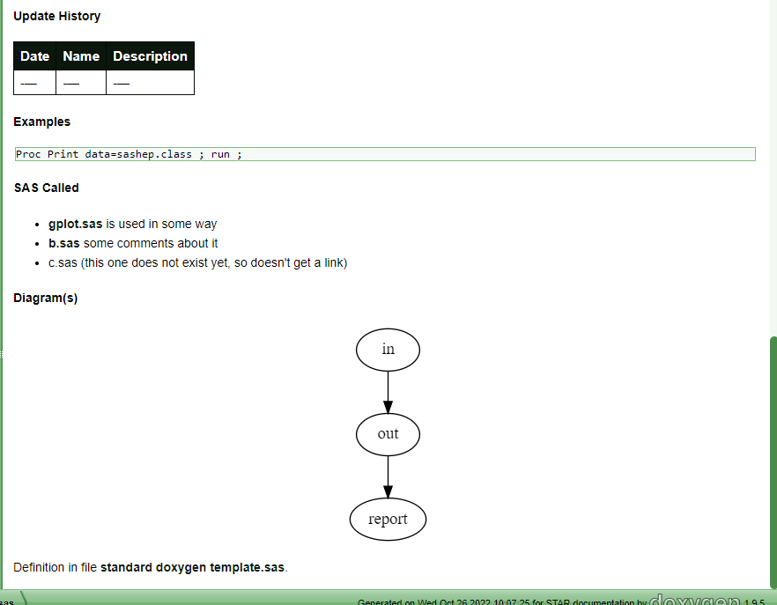
Notes:
Part 3 of 3

Slide 21
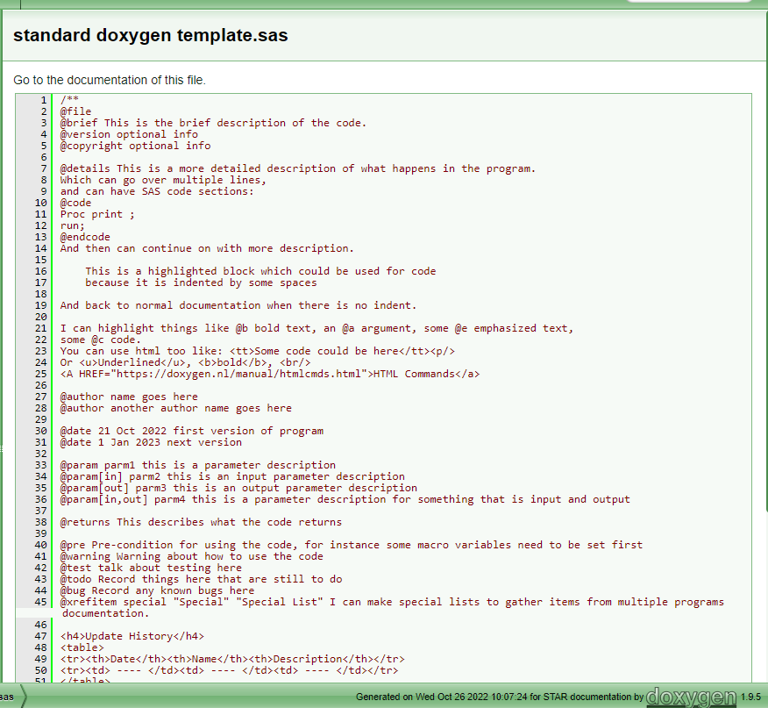
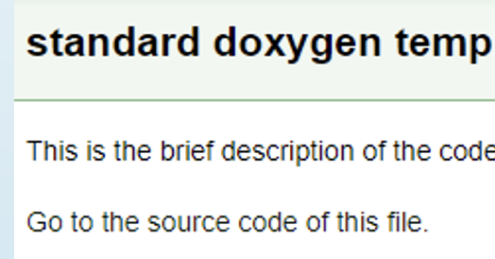
Clicking on source code link from documentation will show this

Slide 22
Diagrams

Slide 23
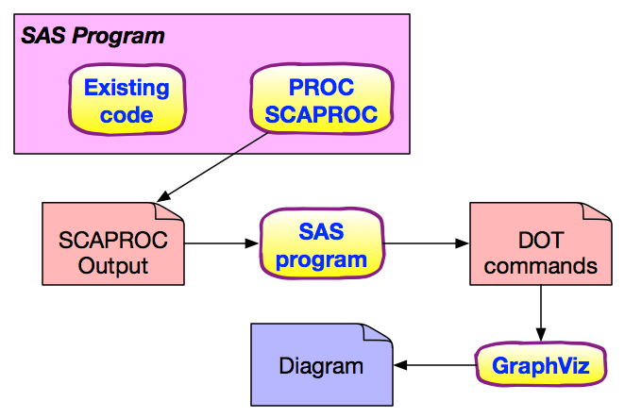
Automatic Diagrams

Slide 24
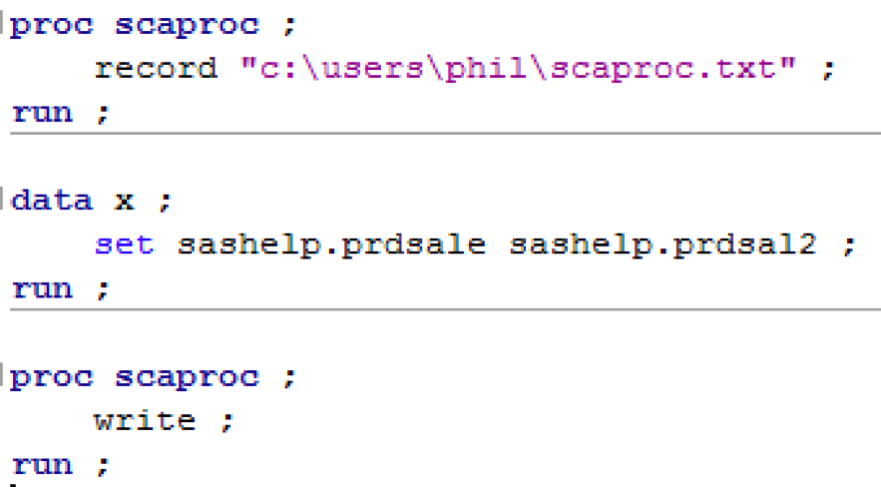
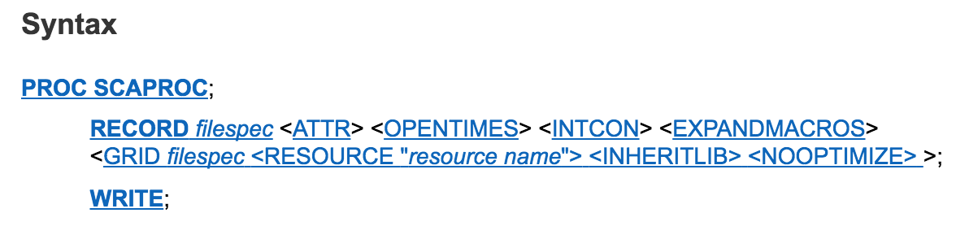
PROC SCAPROC
SAS Code Analyzer, captures info about:
input, output & macro symbols
ATTR - variable attribute info
OPENTIMES - open time, size & physical filename
INTCON - integrity constraint info
EXPANDMACROS - expand macro calls into separate tasks
GRID - help grid enable code

Slide 25
SCAPROC Output
/* JOBSPLIT: JOBSTARTTIME 06MAR2023:07:02:51.92 */
/* JOBSPLIT: TASKSTARTTIME 06MAR2023:07:02:51.92 */
/* JOBSPLIT: DATASET INPUT SEQ #C00001.PRDSALE.DATA */
/* JOBSPLIT: LIBNAME #C00001 V9 'C:\Program Files\SASHome\SASFoundation\9.4\core\sashelp' */
/* JOBSPLIT: CONCATMEM #C00001 SASHELP */
/* JOBSPLIT: LIBNAME SASHELP V9 '( 'C:\Program Files\SASHome\SASFoundation\9.4\nls\en\SASCFG' 'C:\Program Files\SASHome\SASFoundation\9.4\core\sashelp' 'C:\Program Files\SASHome\SASFoundation\9.4\aacomp\sashelp' 'C:\Program Files\SASHome\SASFoundation\9.4\cas\sashelp' 'C:\Program Files\SASHome\SASFoundation\9.4\cmp\sashelp' 'C:\Program Files\SASHome\SASFoundation\9.4\graph\sashelp' 'C:\Program Files\SASHome\SASFoundation\9.4\mlearning\sashelp' 'C:\Program Files\SASHome\SASFoundation\9.4\spdsclient\sashelp' 'C:\Program Files\SASHome\SASFoundation\9.4\stat\sashelp' )' */
/* JOBSPLIT: DATASET INPUT SEQ #C00001.PRDSAL2.DATA */
/* JOBSPLIT: LIBNAME #C00001 V9 'C:\Program Files\SASHome\SASFoundation\9.4\core\sashelp' */
/* JOBSPLIT: CONCATMEM #C00001 SASHELP */
/* JOBSPLIT: LIBNAME SASHELP V9 '( 'C:\Program Files\SASHome\SASFoundation\9.4\nls\en\SASCFG' 'C:\Program Files\SASHome\SASFoundation\9.4\core\sashelp' 'C:\Program Files\SASHome\SASFoundation\9.4\aacomp\sashelp' 'C:\Program Files\SASHome\SASFoundation\9.4\cas\sashelp' 'C:\Program Files\SASHome\SASFoundation\9.4\cmp\sashelp' 'C:\Program Files\SASHome\SASFoundation\9.4\graph\sashelp' 'C:\Program Files\SASHome\SASFoundation\9.4\mlearning\sashelp' 'C:\Program Files\SASHome\SASFoundation\9.4\spdsclient\sashelp' 'C:\Program Files\SASHome\SASFoundation\9.4\stat\sashelp' )' */
/* JOBSPLIT: DATASET OUTPUT SEQ WORK.TEST.DATA */
/* JOBSPLIT: LIBNAME WORK V9 'C:\Users\pmason\AppData\Local\Temp\SAS Temporary Files\_TD9604_ARGENXLAP3120_' */
/* JOBSPLIT: FILE OUTPUT C:\Users\pmason\AppData\Local\Temp\SAS Temporary Files\_TD9604_ARGENXLAP3120_\example1.txt */
/* JOBSPLIT: ELAPSED 29 */
/* JOBSPLIT: SYSSCP WIN */
/* JOBSPLIT: PROCNAME DATASTEP */
/* JOBSPLIT: STEP SOURCE FOLLOWS */
data test ;
set sashelp.prdsale sashelp.prdsal2 ;
run ;
/* JOBSPLIT: JOBENDTIME 06MAR2023:07:02:51.95 */
/* JOBSPLIT: END */
Notes:
JOBSPLIT: DATASET INPUT - tells us what tables were read in by the step
JOBSPLIT: DATASET OUTPUT - tells us what tables were written out by the step
JOBSPLIT: ELAPSED - tells us the elapsed time taken for the step, in milli-seconds
JOBSPLIT: PROCNAME - tells us the type of step, e.g. DATASTEP, FREQ, SORT, etc.

Slide 26
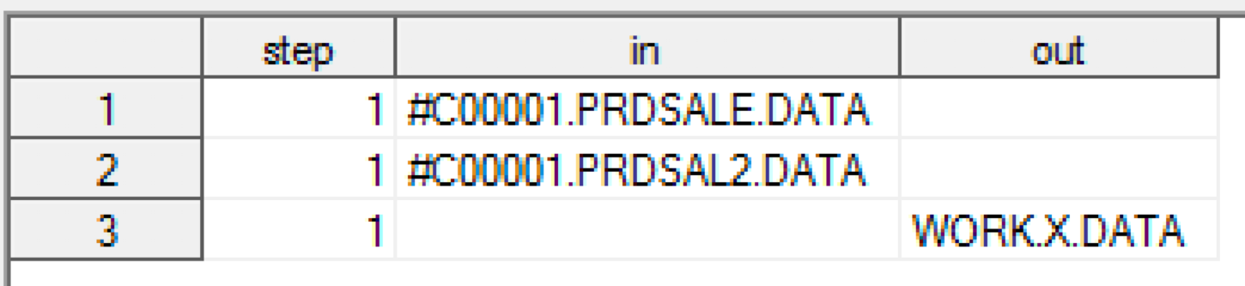
Reading output from PROC SCAPROC
data scaproc_parsed(keep=in out step) ;
retain step 1 ;
infile "c:\users\phil\scaproc.txt" ;
input ;
word1=scan(_infile_,1,' ') ;
word2=scan(_infile_,2,' ') ;
word3=scan(_infile_,3,' ') ;
word4=scan(_infile_,4,' ') ;
word5=scan(_infile_,5,' ') ;
word6=scan(_infile_,6,' ') ;
word7=scan(_infile_,7,' ') ;
if word2='JOBSPLIT:' & word3='DATASET' & word4='INPUT' then in=word6 ;
if word2='JOBSPLIT:' & word3='DATASET' & word4='OUTPUT' then out=word6 ;
if word2='JOBSPLIT:' & word3='STEP' then step+1 ;
if in>'' or out>'' then output ;
run ;
#C00001 should be SASHELP

Slide 27
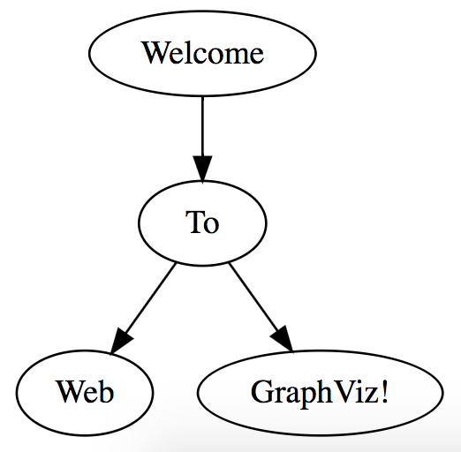
Graphviz Overview
What is Graphviz?
open source graph visualization software
represents structural info
can handle very large/complex graphs
graph is specified in simple text (DOT language)
run via Web (WebGraphViz), HTML 5 canvas JavaScript (CanViz), binaries on your platform
digraph G {
"Welcome" -> "To"
"To" -> "Web"
"To" -> "GraphViz!"
}

Slide 28
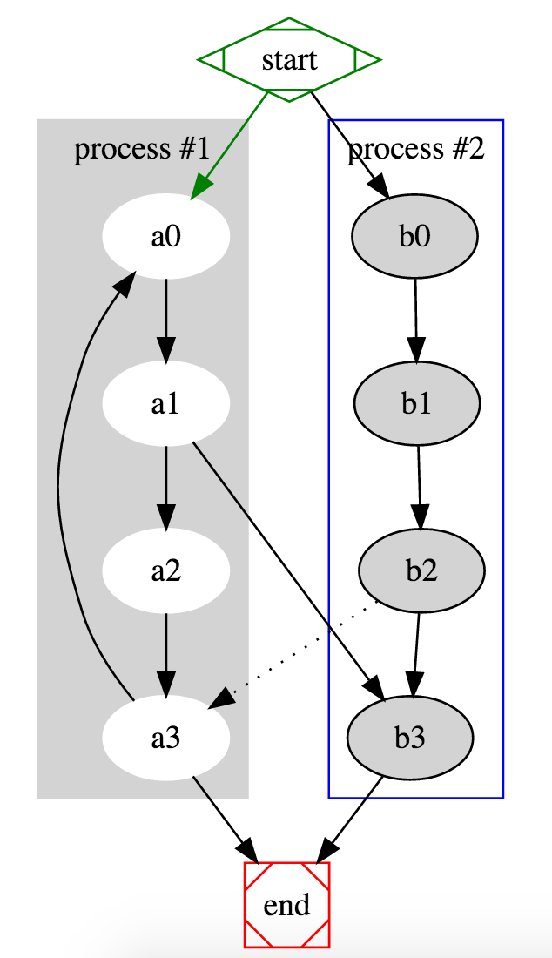
digraph G {subgraph cluster_0 {
style=filled;
color=lightgrey;
node [style=filled, color=white];
a0 -> a1 -> a2 -> a3;
label = "process #1";}
subgraph cluster_1 {
node [style=filled];
b0 -> b1 -> b2 -> b3;
label = "process #2";
color=blue}
start -> a0 [color=green];
start -> b0;
a1 -> b3;
b2 -> a3 [style=dotted];
a3 -> a0;
a3 -> end;
b3 -> end;
start [shape=Mdiamond color=green];
end [shape=Msquare color=red]; }

Slide 29
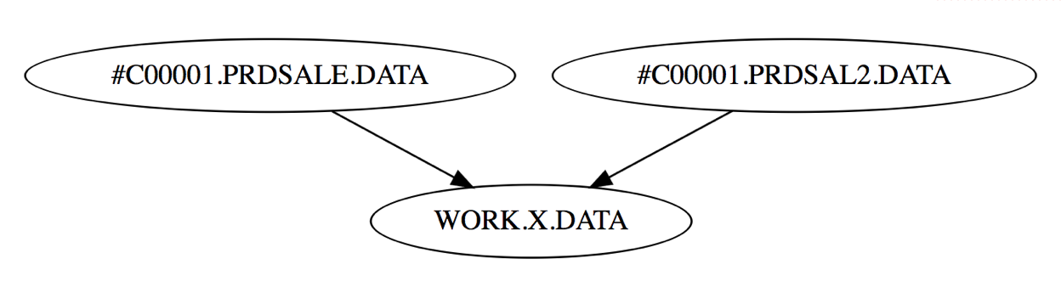
Making DOT commands from SCAPROC
digraph {
"#C00001.PRDSALE.DATA" -> "WORK.X.DATA"
"#C00001.PRDSAL2.DATA" -> "WORK.X.DATA"
}

Slide 30
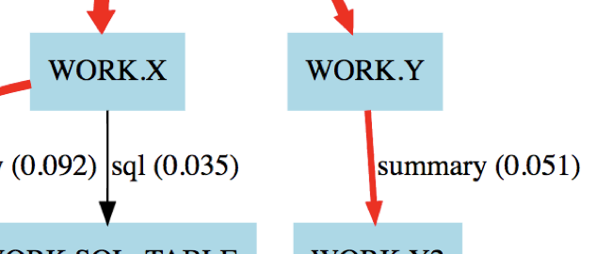
Adding performance information
We can enhance diagram with extra information
Black arrow indicates step took less than median step run time
Red arrow indicates step took longer than median step run time
Thicker arrows indicate longer was taken (e.g. 75th, 90th percentile)
Name of step next to arrow
Actual real time next to arrow

Slide 31
Automating with macros
PROC SCAPROC starts recording
Code runs
PROC SCAPROC stops and writes file
SAS program processes SCAPROC file to produce DOT commands for Graphviz
Percentiles calculated for steps and used to show performance info
%eanbegin
your SAS code
%eanend
%scaproc_analyse
%percentiles
Notes:
macros are in the paper

Slide 32
Using the macros
%eanbegin(text to use as title for diagram)
e.g. %eanbegin(Monthly report flow)
%eanend
%scaproc_analyse
%percentiles(table, variables, pctlpts=percentiles you want)
e.g. %percentiles(sashelp.air, air, pctlpts=25 50 75)

Slide 33
Example using macros
%let _eandebug=scaproc; %* analysis options;
%eanbegin(My code); %* start analysis & give title;
* SAS program code would go here ;
%eanend; %* end analysis & write file;
%scaproc_analyse; %* analyse file & make dataset

Slide 34
SCAPROC output produced
/* JOBSPLIT: JOBSTARTTIME 06MAR2023:07:57:45.32 */
/* JOBSPLIT: TASKSTARTTIME 06MAR2023:07:57:45.32 */
/* JOBSPLIT: DATASET INPUT SEQ #C00001.CLASS.DATA */
/* JOBSPLIT: LIBNAME #C00001 V9 'C:\Program Files\SASHome\SASFoundation\9.4\core\sashelp' */
/* JOBSPLIT: CONCATMEM #C00001 SASHELP */
/* JOBSPLIT: LIBNAME SASHELP V9 '( 'C:\Program Files\SASHome\SASFoundation\9.4\nls\en\SASCFG' 'C:\Program Files\SASHome\SASFoundation\9.4\core\sashelp' 'C:\Program Files\SASHome\SASFoundation\9.4\aacomp\sashelp' 'C:\Program Files\SASHome\SASFoundation\9.4\cas\sashelp' 'C:\Program Files\SASHome\SASFoundation\9.4\cmp\sashelp' 'C:\Program Files\SASHome\SASFoundation\9.4\graph\sashelp' 'C:\Program Files\SASHome\SASFoundation\9.4\mlearning\sashelp' 'C:\Program Files\SASHome\SASFoundation\9.4\spdsclient\sashelp' 'C:\Program Files\SASHome\SASFoundation\9.4\stat\sashelp' )' */
/* JOBSPLIT: OPENTIME #C00001.CLASS.DATA DATE:06MAR2023:07:57:45.33 PHYS:C:\Program Files\SASHome\SASFoundation\9.4\core\sashelp\class.sas7bdat SIZE:131072 */
/* JOBSPLIT: DATASET OUTPUT SEQ WORK.X.DATA */
/* JOBSPLIT: LIBNAME WORK V9 'C:\Users\pmason\AppData\Local\Temp\SAS Temporary Files\_TD9604_ARGENXLAP3120_' */
/* JOBSPLIT: ATTR #C00001.CLASS.DATA INPUT VARIABLE:Name TYPE:CHARACTER LENGTH:8 LABEL: FORMAT: INFORMAT: */
/* JOBSPLIT: ATTR #C00001.CLASS.DATA INPUT VARIABLE:Sex TYPE:CHARACTER LENGTH:1 LABEL: FORMAT: INFORMAT: */
/* JOBSPLIT: ATTR #C00001.CLASS.DATA INPUT VARIABLE:Age TYPE:NUMERIC LENGTH:8 LABEL: FORMAT: INFORMAT: */
/* JOBSPLIT: ATTR #C00001.CLASS.DATA INPUT VARIABLE:Height TYPE:NUMERIC LENGTH:8 LABEL: FORMAT: INFORMAT: */
/* JOBSPLIT: ATTR #C00001.CLASS.DATA INPUT VARIABLE:Weight TYPE:NUMERIC LENGTH:8 LABEL: FORMAT: INFORMAT: */
/* JOBSPLIT: ATTR WORK.X.DATA OUTPUT VARIABLE:Name TYPE:CHARACTER LENGTH:8 LABEL: FORMAT: INFORMAT: */
/* JOBSPLIT: ATTR WORK.X.DATA OUTPUT VARIABLE:Sex TYPE:CHARACTER LENGTH:1 LABEL: FORMAT: INFORMAT: */
/* JOBSPLIT: ATTR WORK.X.DATA OUTPUT VARIABLE:Age TYPE:NUMERIC LENGTH:8 LABEL: FORMAT: INFORMAT: */
/* JOBSPLIT: ATTR WORK.X.DATA OUTPUT VARIABLE:Height TYPE:NUMERIC LENGTH:8 LABEL: FORMAT: INFORMAT: */
/* JOBSPLIT: ATTR WORK.X.DATA OUTPUT VARIABLE:Weight TYPE:NUMERIC LENGTH:8 LABEL: FORMAT: INFORMAT: */
/* JOBSPLIT: SYMBOL GET SCAPROC_LABEL */
/* JOBSPLIT: SYMBOL GET USE_LABEL */
/* JOBSPLIT: SYMBOL SET SCAPROC_LABEL */
/* JOBSPLIT: SYMBOL GET I */
/* JOBSPLIT: SYMBOL SET I */
/* JOBSPLIT: ELAPSED 44 */
/* JOBSPLIT: SYSSCP WIN */
/* JOBSPLIT: PROCNAME DATASTEP */
/* JOBSPLIT: STEP SOURCE FOLLOWS */
data x ; set sashelp.class ; run ;

Slide 35
DOT commands produced by SCAPROC_ANALYSE
// Generated by SAS for Analysis of PROC SCAPROC record of Program Execution
// Percentiles: 10:0.026 50:0.04 90:0.068
digraph test {
graph [label="\n\nAnalysis of PROC SCAPROC record of Program Execution\n06MAR23:07:57:46"]
node [shape=box color=lightblue style=filled]
"_8_PRINT"[shape=ellipse color=lightgreen]
"SASHELP.CLASS"->"WORK.X" [label=" _1_datastep (0.044)" color=orange penwidth=2 style=solid];
"SASHELP.CLASS"->"WORK.Y" [label=" _2_datastep (0.039)" color=lightgreen penwidth=1 style=solid];
"WORK.X"->"WORK.X2" [label=" _3_summary (0.041)" color=orange penwidth=2 style=solid];
"WORK.Y"->"WORK.Y2" [label=" _4_summary (0.040)" color=orange penwidth=2 style=solid];
"WORK.X2"->"WORK.X3" [label=" _5_sort (0.032)" color=lightgreen penwidth=1 style=solid];
"WORK.Y2"->"WORK.Y3" [label=" _6_sort (0.025)" color=grey style=solid];
"WORK.X3"->"WORK.Z" [label=" _7_datastep (0.026)" color=lightgreen penwidth=1 style=solid];
"WORK.Y3"->"WORK.Z" [label=" _7_datastep (0.026)" color=lightgreen penwidth=1 style=solid];
"WORK.Z"->"_8_PRINT" [label="(0.050)" color=orange penwidth=2 style=dashed];
"WORK.X"->"WORK.SQL_TABLE" [label=" _9_sql (0.068)" color=red penwidth=3 style=solid];
"WORK.Y"->"WORK.SQL_TABLE" [label=" _9_sql (0.068)" color=red penwidth=3 style=solid];
}

Slide 36
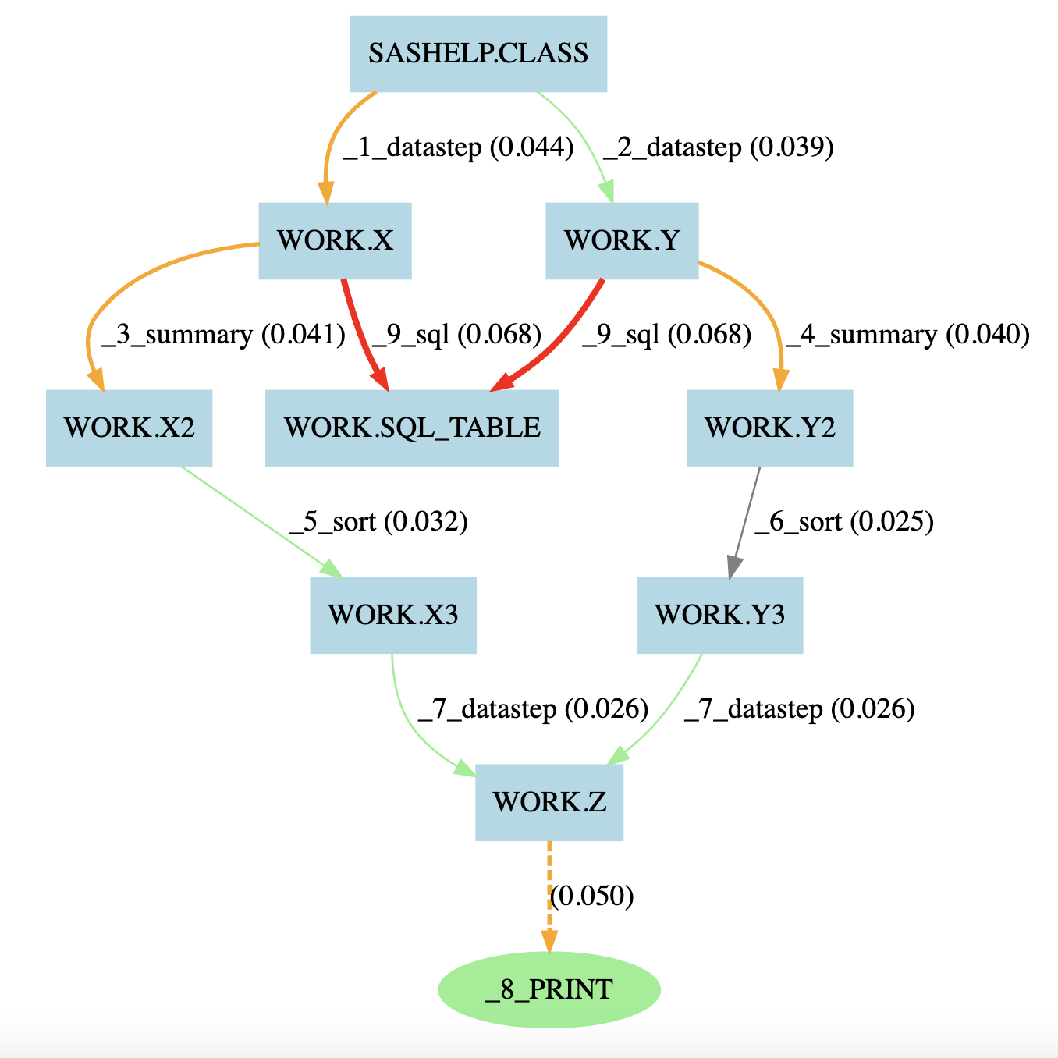
Diagram produced

Slide 37
Future Enhancements
Install Graphviz on local to SAS to automate graph generation
Integrate info from SAS log such as number of rows, CPU time, recs in/out
Fix # librefs in EG
Make a version based on log analysis rather than Proc SCAPROC
attempt a version just based on SAS program code
Integrate into stored process for running via web browser
Store DOT code generated so it can be compared to future versions
allows showing program structure changes, comparing performance
Generate web based diagrams and make us of tooltips and hyperlinks

Slide 38
Conclusions
Start making flow diagrams from your code automatically (almost)
There's nothing to buy or license, you have it all right there
Make diagrams for easy documentation
Use diagrams to quickly understand complex program flows
Quickly spot performance issues in large programs

Slide 39
Questions?
I’ll be outside the room after this talk
Give me your email address if you want updated macros sent to you.

Slide 40
Don't forget to provide feedback!
Go to the Agenda icon in the conference app.
Find this session title and select it.
On the sessions page, scroll down to Surveys and select the name of the survey.
Complete the survey and click Finish.

